Slide 1
Lecture - 21
Chapter 11
FEATURE EXTRACTION

Slide 2
Representation and Description
Boundary-based Descriptors
Freeman chain code
Signature
Shape number
Fourier descriptor
Region-based Descriptors
Some basic descriptors
Topological descriptors
Texture
Statistical approaches
Gray level Co-occurrence Matrix (GLCM)

Slide 3




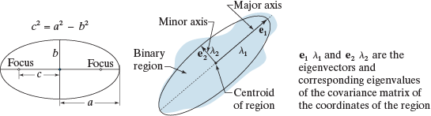



Some Basic Descriptors

Slide 4
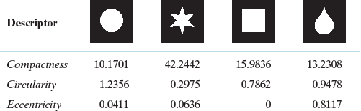

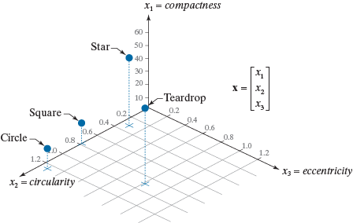
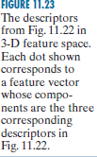
Some Basic Descriptors

Slide 5
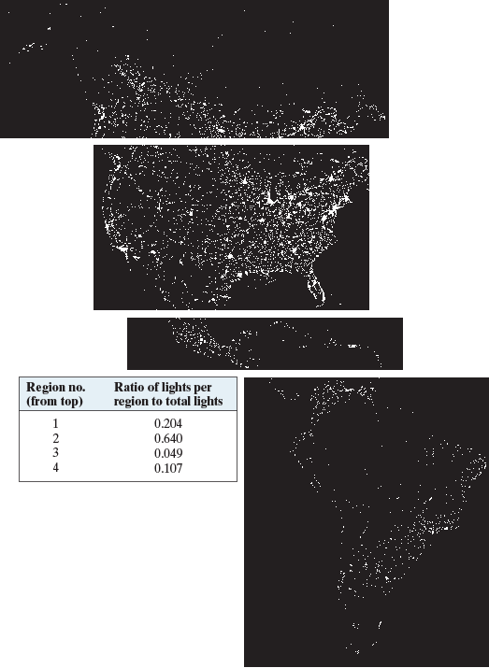

Some Basic Descriptors

Slide 6


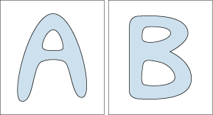

Topological Descriptors
Euler Number E = C - H

Slide 7
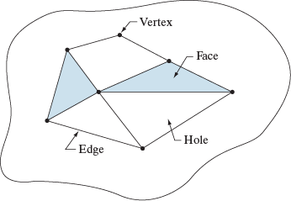

Topological Descriptors
Euler Number E = C – H
E = V – Q – F

Slide 8
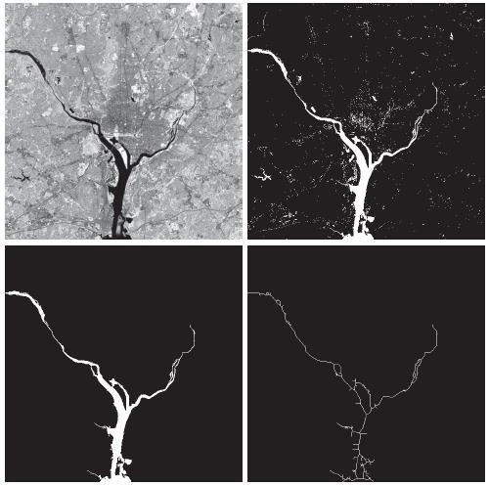
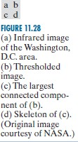
Topological Descriptors

Slide 9
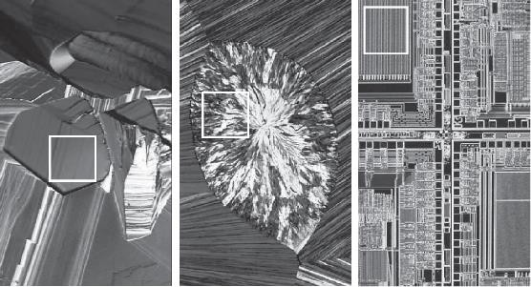
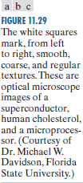




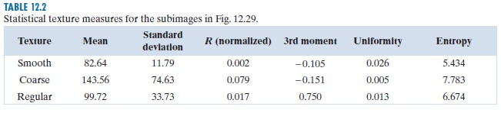

Texture (Statistical Approaches)

Slide 10
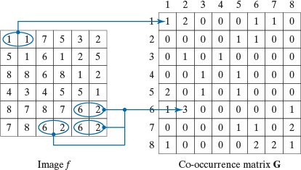

Texture (Gray Level Co-occurrence Matrix - GLCM)

Slide 11
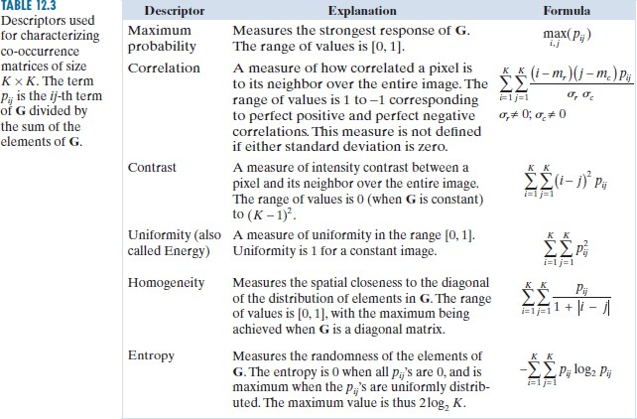
Texture (Gray Level Co-occurrence Matrix - GLCM)

Slide 12
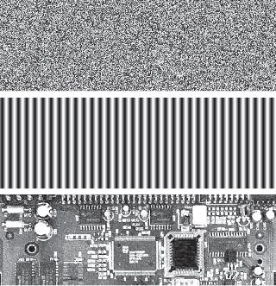

Texture (Gray Level Co-occurrence Matrix - GLCM)

Slide 13

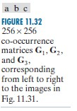
Texture (Gray Level
Co-occurrence Matrix - GLCM)

Slide 14
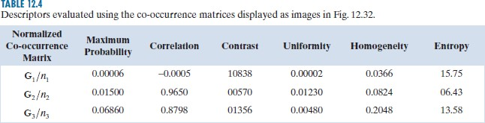
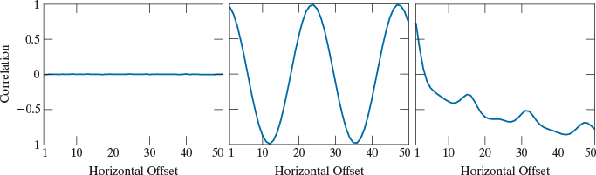
Texture (Gray Level
Co-occurrence Matrix - GLCM)

